Slide 1

Chapter
6
Foundations of Business Intelligence: Databases and Information Management

Slide 2
Management Information Systems
Chapter 6 Foundations of Business Intelligence: Databases
and Information Management
LEARNING OBJECTIVES
Describe basic file organization concepts and the problems of managing data resources in a traditional file environment.
Describe the principles of a database management system and the features of a relational database.
Apply important database design principles.

Slide 3
Management Information Systems
Chapter 6 Foundations of Business Intelligence: Databases
and Information Management
LEARNING OBJECTIVES (cont’d)
Evaluate tools and technologies for providing information from databases to improve business performance and decision making.
Assess the role of information policy, data administration, and data quality assurance in the management of organizational data resources.

Slide 4
Management Information Systems
Chapter 6 Foundations of Business Intelligence: Databases
and Information Management
Nascar Races to Manage Its Data
Problem: Gaining knowledge of customers and making effective use of fragmented customer data.
Solutions: Use relational database technology to increase revenue and productivity.
Data access rules and a comprehensive customer database consolidate customer data.
Demonstrates IT’s role in creating customer intimacy and stabilizing infrastructure.
Illustrates digital technology’s role in standardizing how data from disparate sources are stored, organized, and managed.

Slide 5
Management Information Systems
Chapter 6 Foundations of Business Intelligence: Databases
and Information Management
Organizing Data in a Traditional File Environment
File organization concepts
Problems with the traditional file environment
  Data redundancy and inconsistency
  Program-data dependence
  Lack of flexibility
  Poor security
  Lack of data sharing and availability

Slide 6
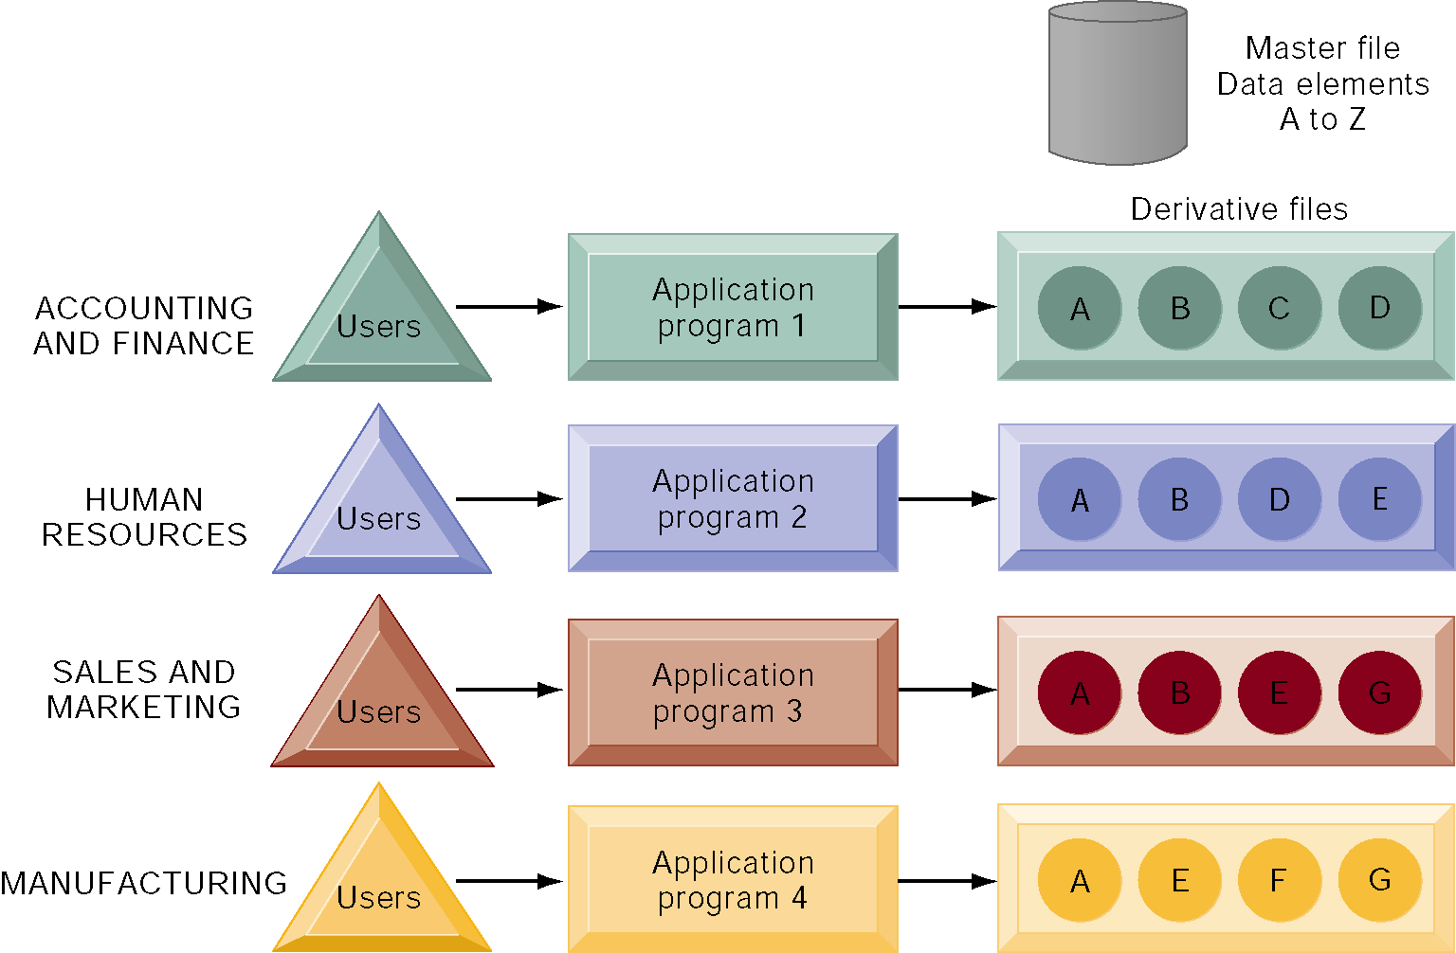
Management Information Systems
Chapter 6 Foundations of Business Intelligence: Databases
and Information Management
Organizing Data in a Traditional File Environment
Traditional File Processing
The use of a traditional approach to file processing encourages each functional area in a corporation to develop specialized applications and files. Each application requires a unique data file that is likely to be a subset of the master file. These subsets of the master file lead to data redundancy and inconsistency, processing inflexibility, and wasted storage resources.
Figure 6-2

Slide 7
Management Information Systems
Chapter 6 Foundations of Business Intelligence: Databases
and Information Management
The Database Approach to Data Management
Database management systems
  How a DBMS solves the problems of the traditional file environment
  Relational DBMS
  Operations of a relational DBMS
  Hierarchical and network DBMS
  Object-oriented DBMS

Slide 8
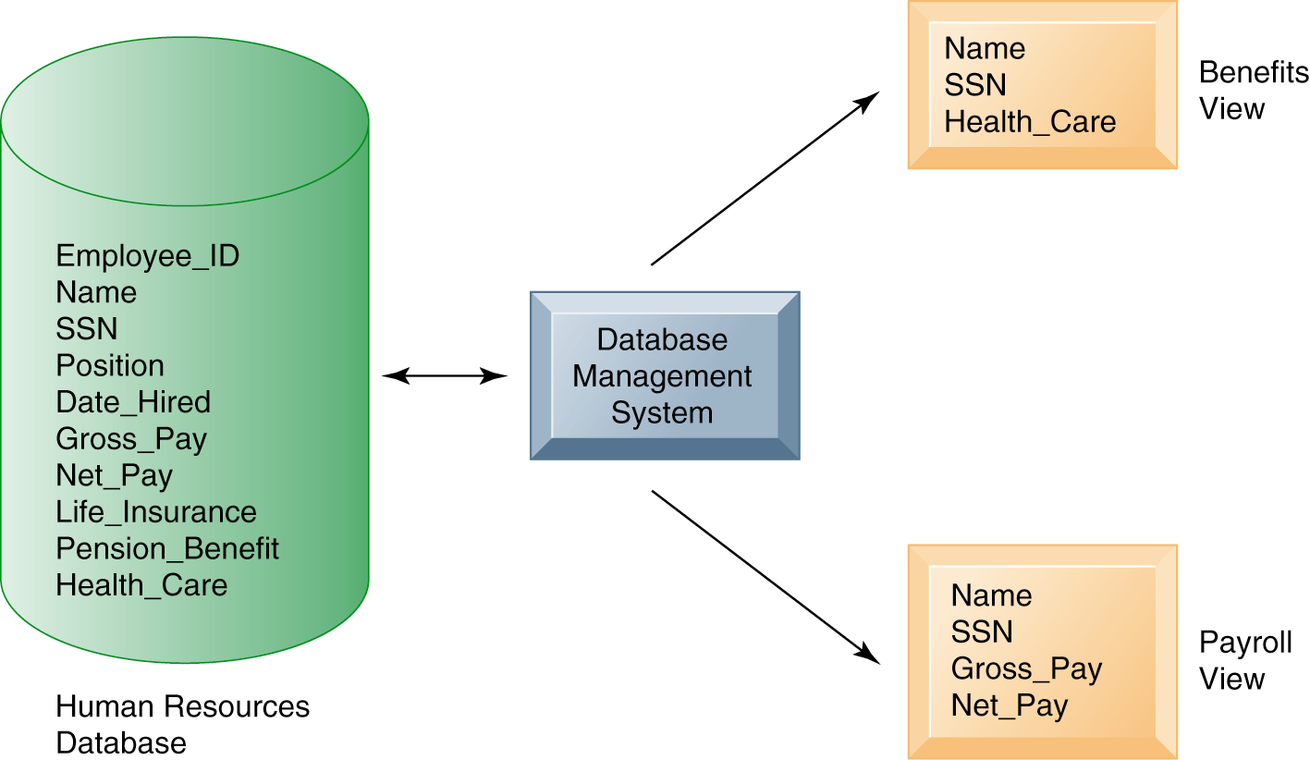
Management Information Systems
Chapter 6 Foundations of Business Intelligence: Databases
and Information Management
The Database Approach to Data Management
Human Resources Database with Multiple Views
A single human resources database provides many different views of data, depending on the information requirements of the user. Illustrated here are two possible views, one of interest to a benefits specialist and one of interest to a member of the company’s payroll department.
Figure 6-3

Slide 9
Management Information Systems
Chapter 6 Foundations of Business Intelligence: Databases
and Information Management
The Database Approach to Data Management
Capabilities of database management systems
  Querying and reporting
Designing databases
  Normalization and entity-relationship diagrams
  Distributing databases

Slide 10
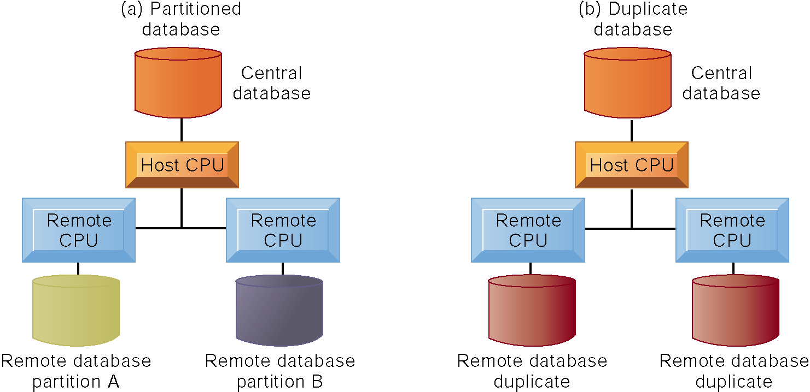
Management Information Systems
Chapter 6 Foundations of Business Intelligence: Databases
and Information Management
The Database Approach to Data Management
Distributed Databases
There are alternative ways of distributing a database. The central database can be partitioned (a) so that each remote processor has the necessary data to serve its own local needs. The central database also can be replicated (b) at all remote locations.
Figure 6-12

Slide 11
Management Information Systems
Chapter 6 Foundations of Business Intelligence: Databases
and Information Management
Using Databases to Improve Business Performance and Decision Making
Database warehouses
  What is a data warehouse?
  Data marts
Online analytical processing (OLAP)
  Data mining
Databases and the Web

Slide 12
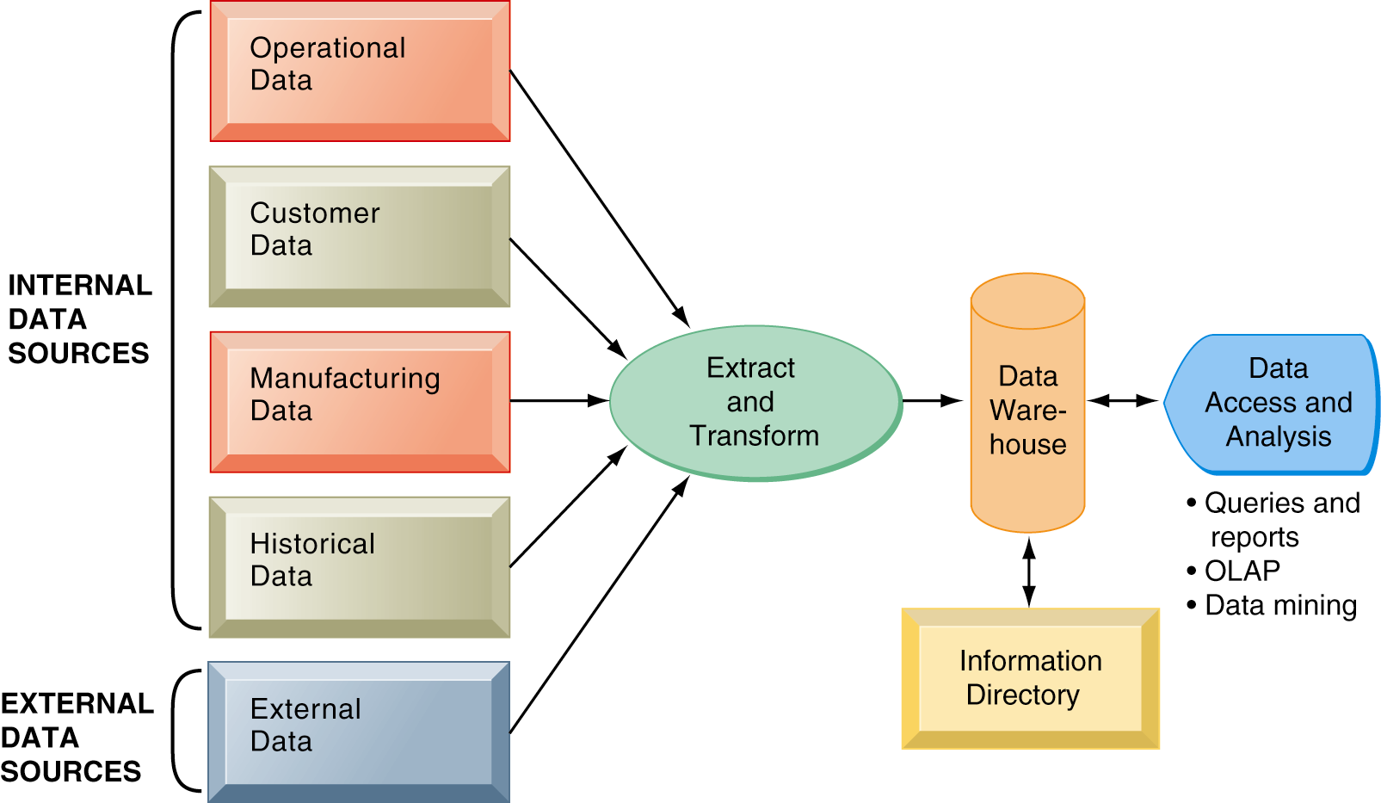
Management Information Systems
Chapter 6 Foundations of Business Intelligence: Databases
and Information Management
Using Databases to Improve Business Performance and Decision Making
Components of a Data Warehouse
The data warehouse extracts current and historical data from multiple operational systems inside the organization. These data are combined with data from external sources and reorganized into a central database designed for management reporting and analysis. The information directory provides users with information about the data available in the warehouse.
Figure 6-13

Slide 13
Management Information Systems
Chapter 6 Foundations of Business Intelligence: Databases
and Information Management
Using Databases to Improve Business Performance and Decision Making
DNA Databases: Crime-Fighting Weapon or Threat to Privacy?
Read the Interactive Session: Management, and then discuss the following questions:
  What are the benefits of DNA databases?
  What problems do DNA databases pose?
  Who should be included in a national DNA database? Should it be limited to convicted felons? Explain your answer.
  Who should be able to use DNA databases?

Slide 14
Management Information Systems
Chapter 6 Foundations of Business Intelligence: Databases
and Information Management
Managing Data Resources
Establishing and information policy
Ensuring data quality

Slide 15
Management Information Systems
Chapter 6 Foundations of Business Intelligence: Databases
and Information Management
Managing Data Resources
What Can Be Done About Data Quality?
Read the Interactive Session: Management, and then discuss the following questions:
  What was the impact of data quality problems on the companies described in this case study? What management, organization, and technology factors caused these problems?
  How did the companies described in this case solve their data quality problems? What management, organization, and technology issues had to be addressed?
  It has been said that the biggest obstacle to improving data quality is that business managers view data quality as a technical problem. Discuss how this statement applies to the companies described in this case study.

